Slide 1
What is the Department of Veterans Affairs (VA) Community Care Network (CCN)?
Notes:
This presentation will provide a high level overview of What is the Department of Veterans Affairs Community Care Network.

Slide 2
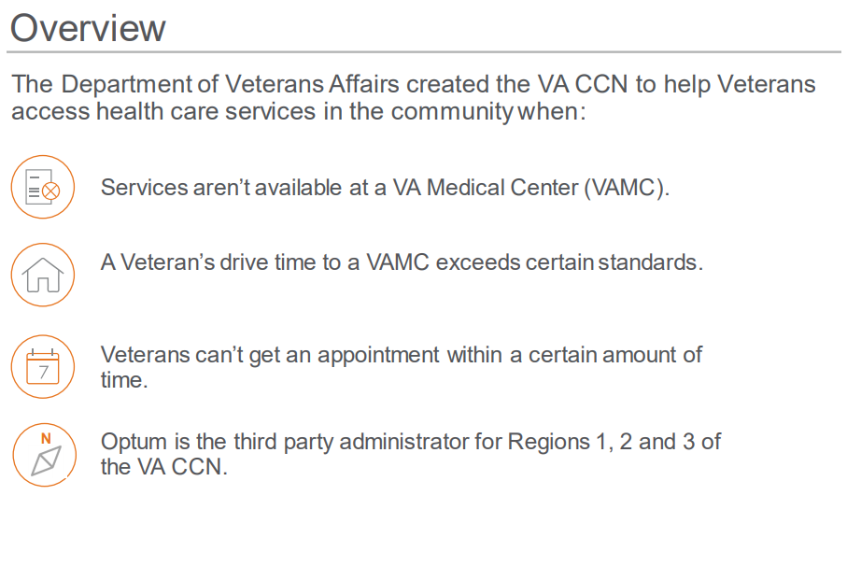
Overview
Users are responsible for ensuring they work from the latest approved version This document was last modified: 02/28/2020
Notes:
The Department of Veterans Affairs created the VA Community Care Network, VA CCN, to help Veterans access health care services in the community when:
Services aren’t available at a VA Medical Center, VAMC.
The Veteran’s drive time to a VAMC exceeds certain standards.
The Veteran can’t get an appointment within a certain amount of time.
Optum is the third party administrator for Regions 1, 2 and 3 of the VA CCN.

Slide 3

Participating Providers
Providers participating in the VA CCN can help Veterans in their community access a network of:
Community health
care facilities
Pharmacies
Primary care physicians, specialists, behavioral providers and more
Users are responsible for ensuring they work from the latest approved version This document was last modified: 02/28/2020
Notes:
Providers participating in the VA CCN can help Veterans in their community access a network of:
Community health care facilities
Pharmacies
Primary care physicians, specialists, behavioral providers and more

Slide 4



Purpose
Help fulfill health care needs for CCN-eligible Veterans
Allow community providers to provide care for Veterans
Help VA meet the health care needs
of Veterans
Users are responsible for ensuring they work from the latest approved version This document was last modified: 02/28/2020
Notes:
The purpose of VA CCN is to:
Help fulfill health care needs for CCN eligible Veterans
Allow community providers to provide care for Veterans
Help VA meet the health care needs of Veterans

Slide 5
Delivering Care
Referrals, Reimbursement and Start Dates
VA will refer Veterans to community providers
  VA determines eligibility and will refer those eligible Veterans for
  community care.
Participating providers will be reimbursed at 100% of
Medicare rates
  If Medicare rates aren’t available, please refer to the payment appendix for additional reimbursement details.
Start of health care delivery will vary depending on your location
  Contract implementation will occur in phases through the summer of 2020. If you have questions, please visit provider.vacommunitycare.com.
Users are responsible for ensuring they work from the latest approved version This document was last modified: 02/28/2020
Notes:
When it comes to Referrals, Reimbursement and Start Dates:
VA will refer Veterans to community providers
VA determines eligibility and will refer those eligible Veterans for community care.
Participating providers will be reimbursed at 100% of Medicare rates
If Medicare rates aren’t available, please refer to the payment appendix for additional reimbursement details.
Start of health care delivery will vary depending on location
Contract implementation will occur in phases through the summer of 2020. If you have questions please visit provider.vacommunitycare.com.

Slide 6
VA Health Benefit Package
A referral will only include services that are part of the VA health benefit package.
Basic Medical Services
(Not inclusive list)
Complementary and Integrative Health Services
Exceptions and Exclusions
• Acupuncture
• Ancillary services (i.e., dialysis)
• Behavioral health
• Dental
• Diagnostic services
• Durable medical equipment
• Emergent care
• Home health care and hospice
• Hospital services
• Immunizations
• Implants
• Maternity
• Pharmacy
• Preventive care
• Reconstructive surgery
• Rehabilitative services
• Routine vision
• Skilled nursing facility (100 days)
• Biofeedback
• Hypnotherapy
• Massage therapy
• Native American healing
• Relaxation technique
examples:
– Meditation
– Guided imagery
  • Tai chi
Exceptions:
• Ambulance services
• Home deliveries/midwives
• Nursing home care
• Veteran travel
• Out-of-network services
Exclusions:
• Abortion
• Gender alterations
• Membership for spas or
health clubs
Users are responsible for ensuring they work from the latest approved version This document was last modified: 02/28/2020
Notes:
Slide includes automation. Click to highlight areas to be discussed.
Say: The Community care network is referral based. VA purchases services in the community by issuing referrals to CCN providers. A referral will only include services that are part of the VA health benefit package.
The health benefit package contains Basic Medical Services listed here, this is not an inclusive list.
<Click> For routine vision, referrals will be for services only. Any vision-related materials such as eyeglasses are provided by VA. Veterans will need to fill their prescription for all vision related materials with their local VA facility.
<Click> as part of the VA health benefits package VA also offers Complementary and Integrative Heath Services based on VA’s determination that they promote, preserve, and restore health
<Click> There are exceptions and exclusions to a Veterans benefits- Exceptions may be payable by VA under a Veteran’s health Benefit Package but are not included in your CCN contract and will not be requested on a CCN referral where Exclusions are services that are not covered under a Veteran’s health benefit package and will not be reimbursed by VA or under your CCN contract

Slide 7






Lifecycle of Veteran Care
VA
CCN Provider
VA
Referral Generated
Referral Received
Appointment
Medical Records
Claims
Episode of Care Complete
VA contacts provider to accept referral or schedule appointment
Provider accepts referral, receives
and reviews referral packet
Provider sees the Veteran. Prescribes medication as appropriate
Provider
sends medical documentation
to VA
Provider submits claim to Optum
VA receives medical documentation and completes the referral
Before Visit
Prior to Appointment
During Appointment
After Visit
Care Completed
Users are responsible for ensuring they work from the latest approved version This document was last modified: 02/28/2020
Notes:
This is the lifecycle when a Veteran is receiving care by a CCN provider.
VA assess the Veterans condition and makes a clinical decision on services needed. Based on the Veterans eligibility for community care and availability of services at the VA Medical Center, the Veteran may be referred to a community provider. The VA Medical Center’s Office of Community Care will contact a provider to request acceptance of a referral and schedule an appointment. Once a provider accepts the referral, VA will send the referral packet to the CCN provider based on the provider’s preferred method to receive it. A Veteran may prefer to schedule themselves, after the provider accepts the referral.
From here front office staff such as schedulers or receptionists prepare for the Veterans visit. Providers will understand what VA is requesting by reviewing the referral packet, they provide and coordinate care with VA. Back office staff, such as medical records and billing will submit medical documentation and file claims.

Slide 8
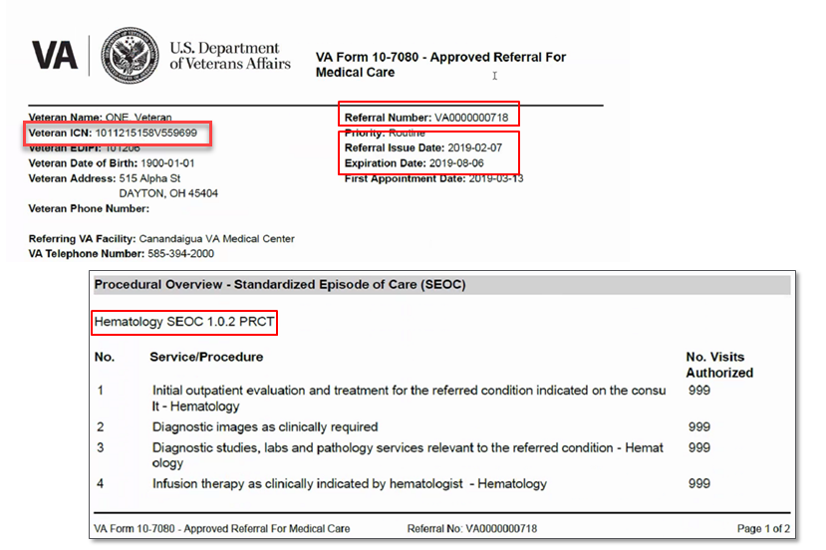
Referral and Standardized Episode of Care (SEOC)
Users are responsible for ensuring they work from the latest approved version This document was last modified: 02/28/2020
Notes:
The referral packet will include the referral with a Standardized Episode of Care or SEOC, consult/order with chief complaint, patient history and clinical findings related to the chief complaint.
The consult/order states what the VA provider is requesting from the community provider.
VA does not want to delay treatment of a Veteran, in addition to the consult/order the provider is approved for all medically necessary services for the quantities listed on the SEOC. When you see 999 this is a placeholder as there are not a standard number of visits for the service-use your clinical judgement to provide medically necessary care to Veterans
The SEOCs will indicate a set of services and procedures that relate to a specific category of care or sub-specialty. VA has revised the SEOCS to be more inclusive to avoid the need to go back to VA for additional approvals while treating a Veteran
The VA is required by law to bill Third Party Payers (TPP) for care that is not related to a Veteran’s service-connected disability or Special Authority. This requires VA to call TPPs for precertification for patients who are Veteran Health Administration beneficiaries with other billable health insurance (OHI). Further instruction will be provided on the referral and are available on va.gov/communitycare under Precertification Requirements
On this referral the referral number is listed along with the SEOC: Hematology SEOC 1.0.2 PRCT---
The referral also contains the length of time it is valid, this one is for 6 months.
The expiration date may change based on the first appointment to allow for the complete timeframe from appointment to expiration date. When recalculated a new referral is not issued however provider will be able to see the update in HSRM or the secure provider portal.
The referring VA facility and contact information is also on the referral.
Under the Veteran Name you will see the Veteran Integration Control Number (ICN) you can now use this number or the Veteran’s Social Security Number as the member ID

Slide 9
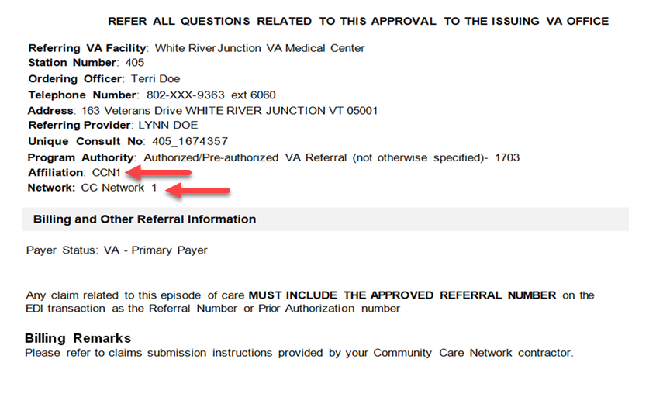
Referral and Standardized Episode of Care (SEOC) (cont.)
Users are responsible for ensuring they work from the latest approved version This document was last modified: 02/28/2020
Notes:
On the referral you will see details and contact information at the referring VA Medical Facility as well as billing information. When an approved referral is generated VA is always the primary payer.
The affiliation and Network is very important to recognize during the transition from PC3 to Optum as the third party administrator for the Community Care Network. Here you will see the Affiliation listed as CCN 1, 2 or 3 and the Network as CC Network 1, 2 or 3 depending on region.

Slide 10







Requesting Additional Services
A referral request must be submitted to VA using a Request for Services (RFS) form on the same day you determine the care is needed and when requesting:
Additional services that are not part of the SEOC
Additional visits
An extension to the length of the referral
Veteran needs care by another provider for services
not listed on the SEOC
Service will be provided at VA or a referral will be communicated back to the referring CCN provider for approved services.
Users are responsible for ensuring they work from the latest approved version This document was last modified: 02/28/2020
Notes:
If a provider identifies a need for additional care that falls outside of the original referral and SEOC or there is a need to extend the duration of the referral, a Request for Services (RFS) form must be submitted to VA for review. The goal of the VA Medical Center is to process all requests within three business days. The community provider will be notified of the decision or outcome via their preferred method of communication. The notification will also indicate if the care will be provided within VA or in the community. This form is also used for requests for VA to fulfill DME, Prosthetic, eyeglasses, and oxygen requests.

Slide 11
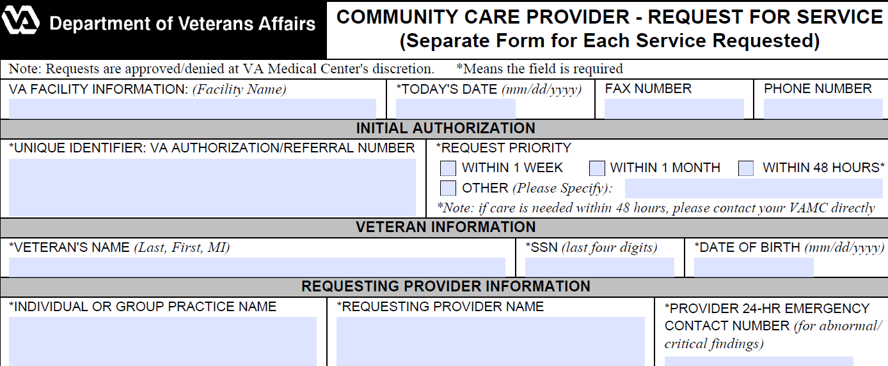
Request for Services (RFS)
Example of an RFS form:
An RFS must be submitted to VA on the same day the provider determines the care is needed. This form is available at provider.vacommunitycare.com > Documents & Links.
Users are responsible for ensuring they work from the latest approved version This document was last modified: 02/28/2020
Users are responsible for ensuring they work from the latest approved version. This document was last modified: 11/27/2019
Notes:
Here is the Request for services form. The provider is required to send the completed form to the VA the same day the provider determines care is needed.
This form can be uploaded into HSRM or sent to VA through secure email or secure fax and must include the provider signature, The signature is necessary since the RFS form serves as physician orders. This form is available at provider.vacommunitycare.com > Documents & Links

Slide 12

Medical Documentation
Maintain medical records that are current, detailed
and organized
Medical documentation must be in a legible format
As part of the required VACCN medical documentation, providers must have a release of medical records, which includes the Veteran’s signature, on file.
Outpatient care | Within 30 days of the Veteran’s initial appointment Within 30 days of completing care on a referral
Inpatient Care | Within 30 days of discharge to include, at minimum, the discharge summary
Additional VA requests | A submission deadline will be indicated on medical documentation requests from VA. Medical documentation is required within 24 hours of receiving an urgent request from VA.
Users are responsible for ensuring they work from the latest approved version This document was last modified: 02/28/2020
Notes:
As part of the VA CCN medical documentation requirements, providers must have a release of medical records, which includes the Veteran’s signature on file.
Outpatient care requires medical documentation to be sent to VA within 30 days of the Veterans initial appointment. The provider will submit medical documentation again within 30 days of completing the episode of care on the referral.
Inpatient care requires documentation to be sent to VA within 30 days of discharge to include at a minimum, the discharge summary.
VA may send additional medical documentation requests and will provide turn around times with their request.

Slide 13
Claims Guidelines
Claims must be submitted to Optum within 180 days from the date of service.
A referral number (VA + 10 digits) must be on each submitted claim.
Use the Veteran’s Social Security number (SSN) or Integration Control Number (ICN) as the member ID.
Providers submit claims on approved claim forms with the National Provider Identifier (NPI) number and Tax ID number (TIN) or SSN.
Do not submit medical documentation with claims. All medical documentation must be submitted directly to local VA.
Claims reconsideration requests must be submitted to Optum within 90 days from the date of denial and within 12 months from process date when the claim has not been denied but the provider believes the claim has been incorrectly paid.
The in-network emergency department must contact the local VA within
72 hours of beginning emergent care.
When a Veteran receives services for emergency care from an out-of-network provider, the claim needs to be submitted to VA within 90 days
of encounter. VA will evaluate eligibility for payment and process claims accordingly.
Users are responsible for ensuring they work from the latest approved version This document was last modified: 02/28/2020
Notes:
Claims are required to be submitted to Optum within 180 days from the date of service
The referral number will be VA+10 digits. This is required on all claims submitted.
Use the Veteran’s Social Security number or ICN as the member ID
Providers bill with NPI and TIN or SS#
Do not submit Medical Documentation with claims, all Medical Documentation must be submitted directly to the local VA.
Claims reconsideration requests must be submitted to Optum within 90 days from the date of denial and within 12 months from the process date when a claim has not been denied but the provider believes the claim has been incorrectly paid.
As long as a participating CCN Emergency dept notifies VA within 72 hours of an ER visit and the Veteran is eligible for community care the notification will generate a consult/order and a retroactive referral will be generated for the claim to be paid by Optum.
When a Veteran receives services for emergency care from an out-of-network provider the claim needs to be submitted to VA within 90 days of encounter. VA will evaluate eligibility for payment and process claim accordingly.

Slide 14
Claims Process
Providers must submit a claim on a nationally recognized claim form:
CMS 1500
(Add referral number to box 23)
CMS 1450 / UB04
(Add referral number to field 63A)
Dental Providers ADA claim form
(Add referral number to field 2)
Methods to submit a claim to Optum:
Electronic Data Interchange (EDI): Payer ID is VACCN
Mail:
VACCN Optum
P.O. Box 202117
Florence, SC 29502
Secure Fax: 833-376-3047
Online: vacommunitycare.com > I am a Provider > Medical/Behavioral Provider
Users are responsible for ensuring they work from the latest approved version This document was last modified: 02/28/2020
Notes:
In order to be reimbursed a national recognized claim form must be used to include a
CMS 1500 Place the referral number in Box 23.
CMS 1450 / UB04: Place the referral number in field 63A, home health agencies and skilled nursing facilities using Outcome and Assessment Information Set (OASIS) should put the 18 byte treatment authorization code in field 63B
dental providers and medical providers billing approved dental procedures use an ADA claim form , referral # goes in field 2, additional information on dental billing is available at provider.vacommunitycare.com > Training & Guides > Dental Provider
All claims require the referral number.
Providers can file claims through EDI with the payer id VACCN, by using the portal, mail or secure fax.
This information is also available in the Provider Manual and the Provider Services and Resources document at provider.vacommunitycare.com

Slide 15
Support Services
VA CCN Provider Services
VA CCN Provider Portal provider.vacommunitycare.com
View referrals
Submit claims
Link to VA CCN provider directory
Access claim information
Verify Veteran eligibility
Monitor real-time pharmacy
dispensing information
Chat with provider services
CCN Provider Services
Region 1: 888-901-7407
Region 2: 844-839-6108
Region 3: 888-901-6613
    Benefit issue resolution
    Claim status and issue resolution
    Pharmacy issue resolution
    Provider enrollment
    Referral status
    Veteran eligibility
Users are responsible for ensuring they work from the latest approved version This document was last modified: 02/28/2020
Notes:
There are services to support CCN providers:
Access the VA CCN Provider Portal, provider.vacommunitycare.com to:
View referrals
Submit claims
Link to the VA CCN provider directory
Access claim information
Verify Veteran eligibility
Monitor real-time pharmacy dispensing information
Chat with provider services
Use the CCN Provider Services
Benefit issue resolution
Claim status and issue resolution
Pharmacy issue resolution
Provider enrollment
Referral status
Veteran eligibility

Slide 16
Self-Service Functionality
Notes:
Note that providers cannot use LINK for any self-service functionality for VA CCN.
Note that advocates will not have access to the VA CCN secure portal due to the level of government NAC clearance that is required.

Slide 17
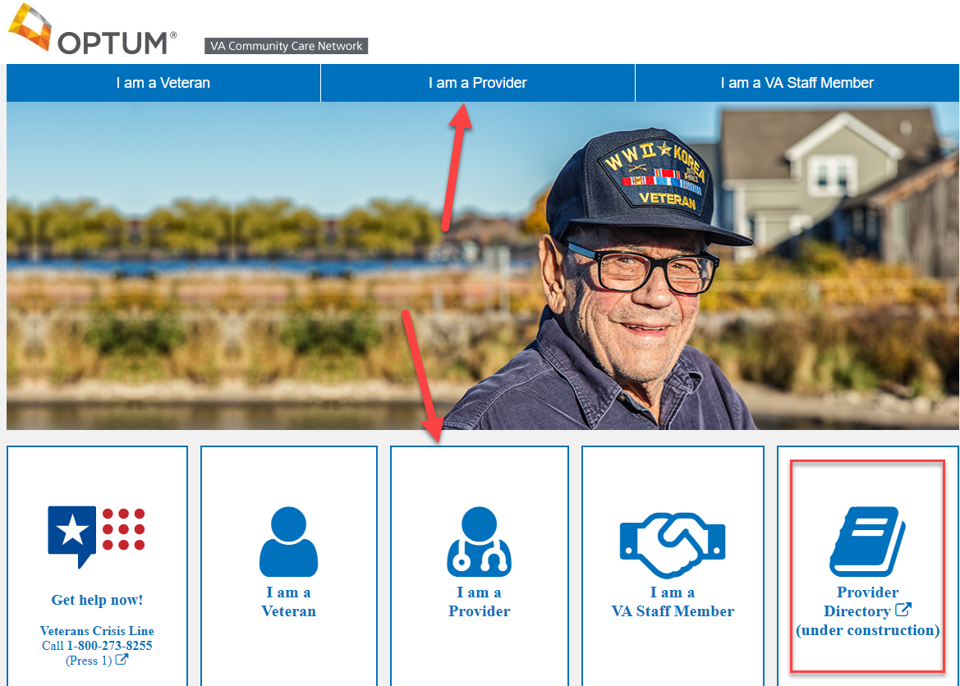
Notes:
All self-service actions start at vacommunitycare.com
The provider will choose “I am a Provider”

Slide 18
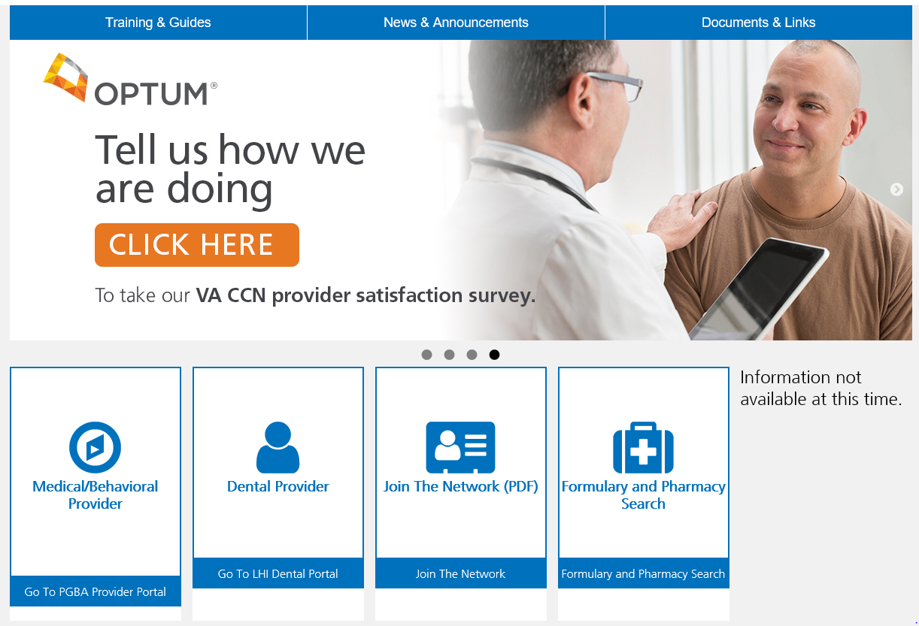
Notes:
After choosing “I am a provider” it will bring you to this page.
From the provider landing page you can access the secure Medical/Behavioral Provider or Dental Provider portals – we will discuss this later in the training.
In the tool bar you can access
Training and Guides
News and Announcements and
Documents and Links
If you are not contracted for VA CCN, and are interested in doing so, click “Join the Network” or call CCN Provider Services at 888-901-7407.

Slide 19
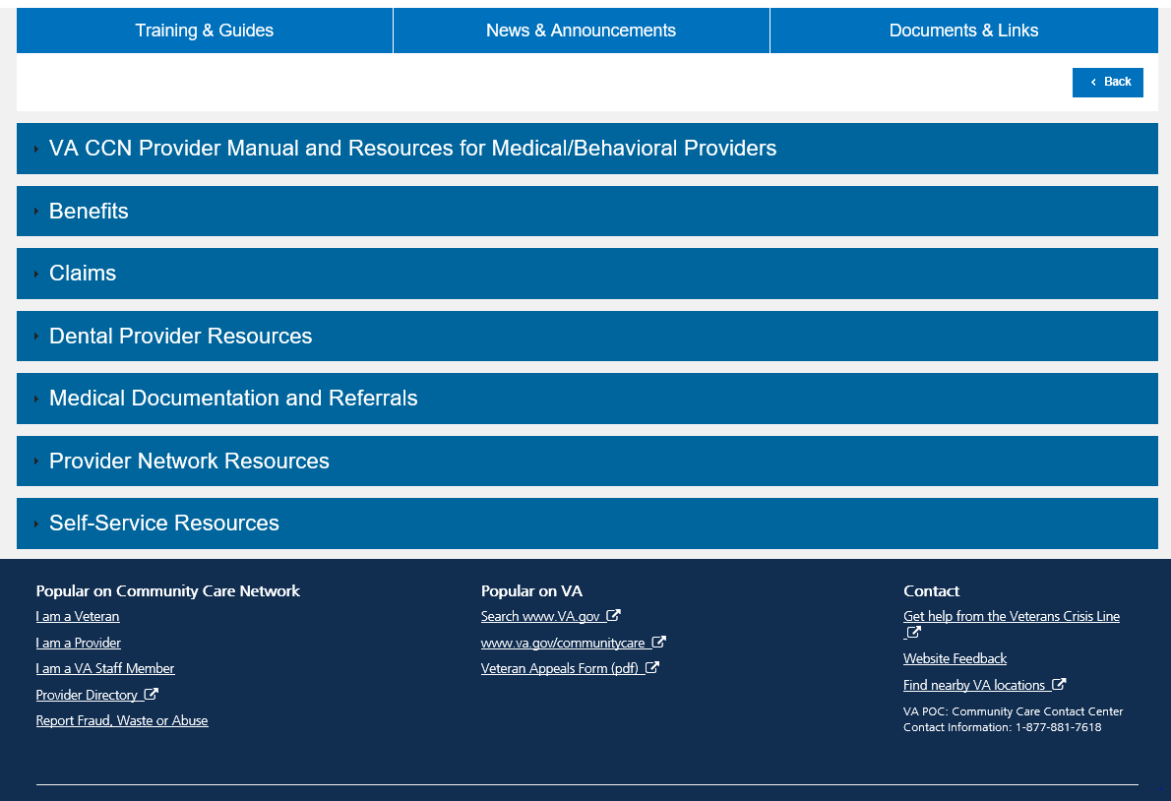
Notes:
This is the screen that the provider will see when they choose the “Training & Guides” link.
Direct the providers to this area to find items such as the provider manual, the claims information that I have shared the links to, etc.

Slide 20
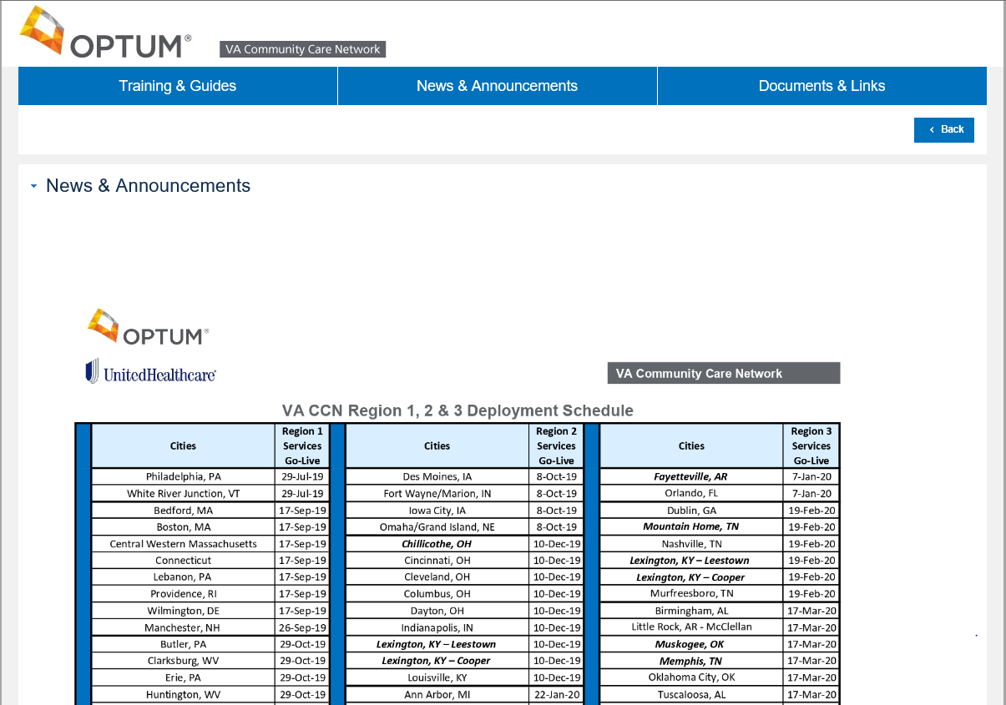
Notes:
When the provider navigates to the News and Announcements page they will find:
A health care delivery schedule
Invitations with webinar links to register for an educational overview of VA CCN.
Advocates should be directing providers to this site and highly recommending that they participate in an Optum education webinar.
Providers can attend ANY region as they are not specific and contain all of the same content. Region 2 trainings are set to go through Feb 14th and Region 3 through May 1st.
There is a also link to the Provider Satisfaction Survey from this page as well as the documents and links section.
Advocates should encourage providers to complete the survey as it helps VA and Optum continue to improve VA CCN effectiveness and experience for Veterans, providers, VA and Optum.

Slide 21
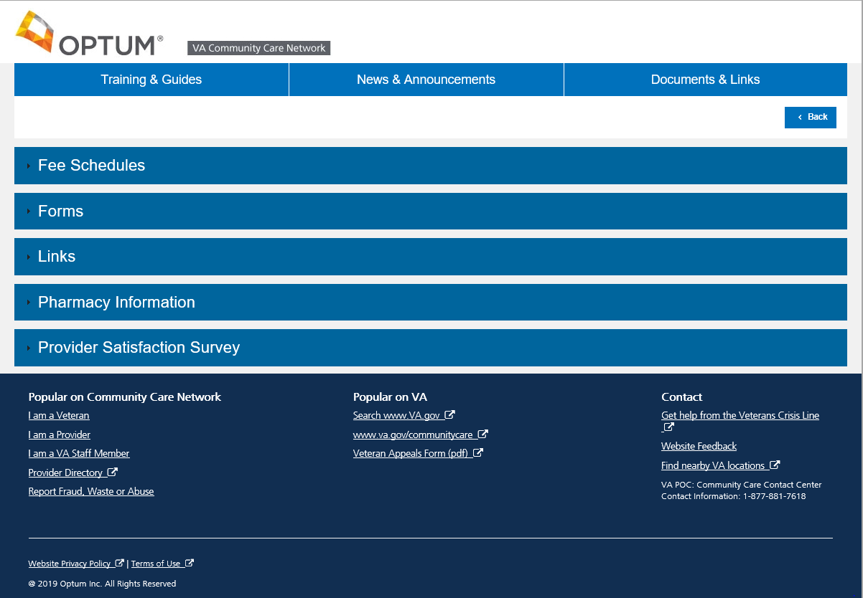
Notes:
This is what the provider will see when they navigate to Documents and Links
Here they will find items such as the Request for Services Form, copies of fee schedules, and links to the websites of other affiliates that work with VA CCN such as Optum Physical Health, Logistics for dental, etc.

Slide 22
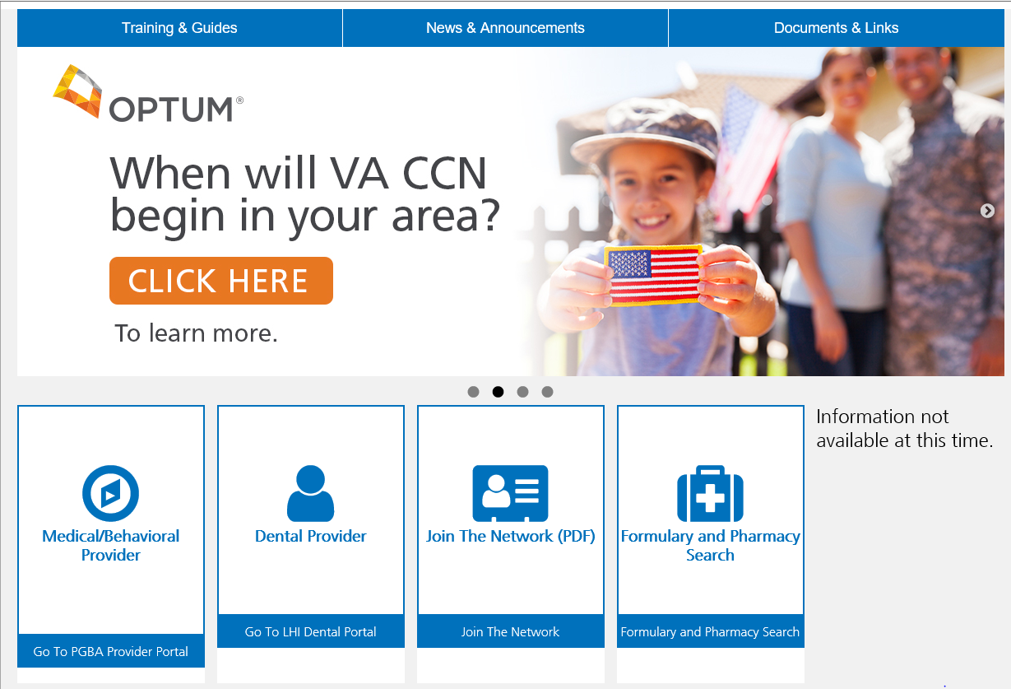
Notes:
To access the secure portion of the provider portal the provider will navigate to vacommunitycare.com > I am a Provider > then the Medical/Behavioral Provider tile.

Slide 23
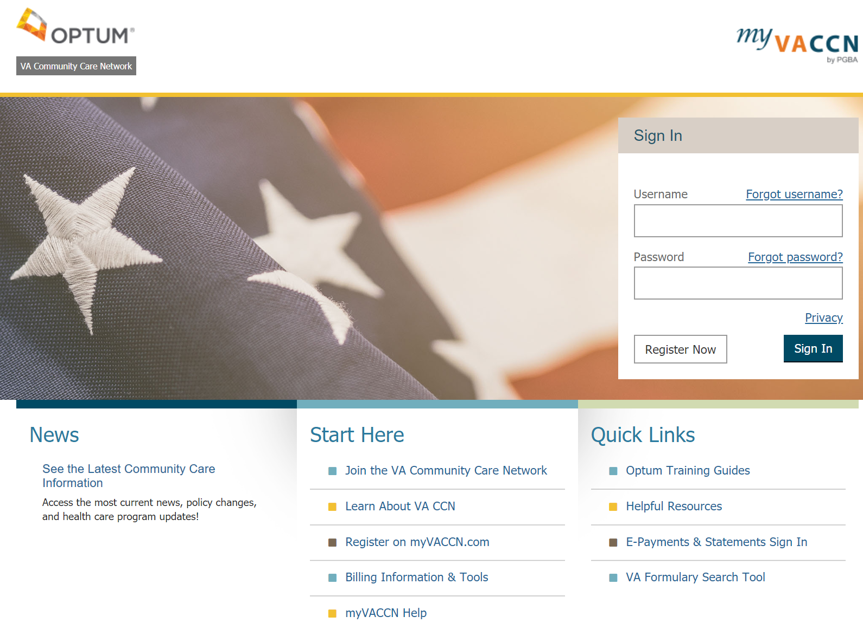
Notes:
They will be directed to My VACCN which is owned by PGBA.
UHC Advocates will not have access to use this tool as this requires government NAC clearance.
Providers will have to provide their TIN, state, zip code, last four digits of their social security number and DOB in order to register.

Slide 24
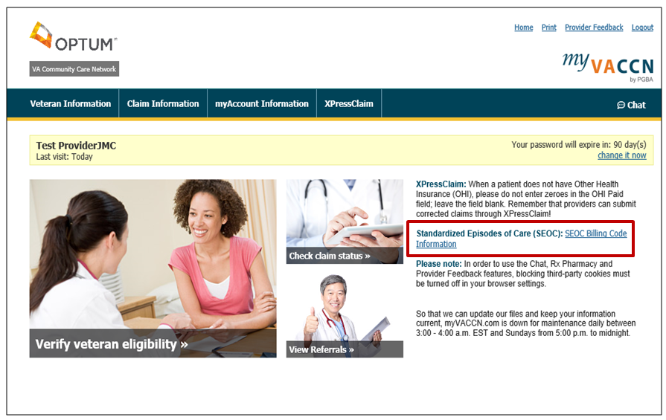
Notes:
After logging in the provider can select the functionality needed:
Verify Veteran eligibility
Check claim status
Or view referrals
There is a hyperlink to open the SEOC Billing Code Information on va.gov for an inclusive list of procedures approved on a referral.

Slide 25
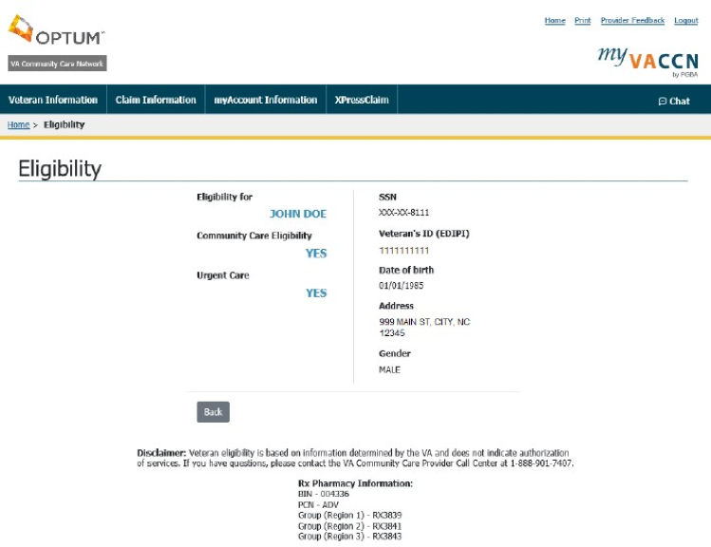
Notes:
Once the provider chooses Veteran information, eligibility, and enters in the required information they will see this screen.
They will see immediately if the patient is eligible for Community Care or Urgent Care.
At this time Optum does not administer the Urgent Care benefit so providers need to continue to work with their PC3 contractor for this benefit.
Additionally the necessary information when writing a prescription is housed on this screen as well.

Slide 26
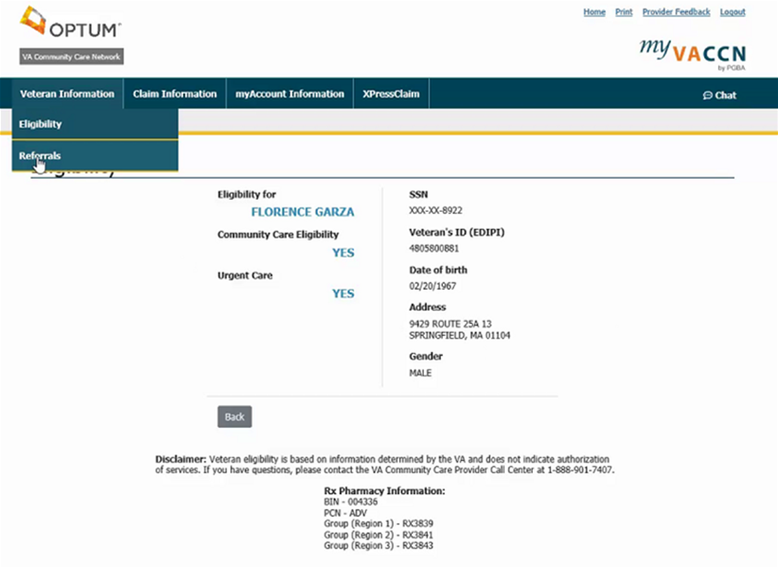
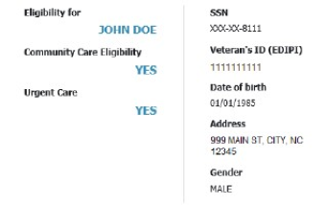
Notes:
The next option that the provider could choose under Veteran Information is referrals.

Slide 27
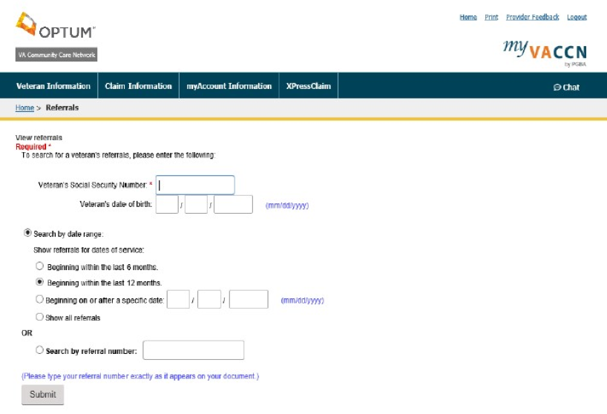
Notes:
The provider will enter the veterans identifying information as well as the date range they wish to search.
If they have a referral number already that can chose to use that instead.

Slide 28
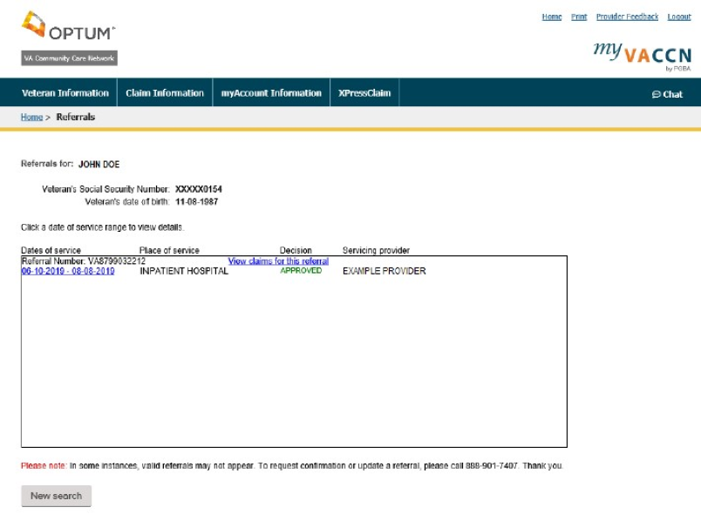
Users are responsible for ensuring they work from the latest approved version. This document was last modified: 08/14/2019
Notes:
Once that information is submitted the provider will come to this screen.
The referral in this example is approved – noted in green AND
The referral number is VA8799032212.
In order to see additional information regarding this referral the provider would need to click on the date hyperlink to the left.

Slide 29
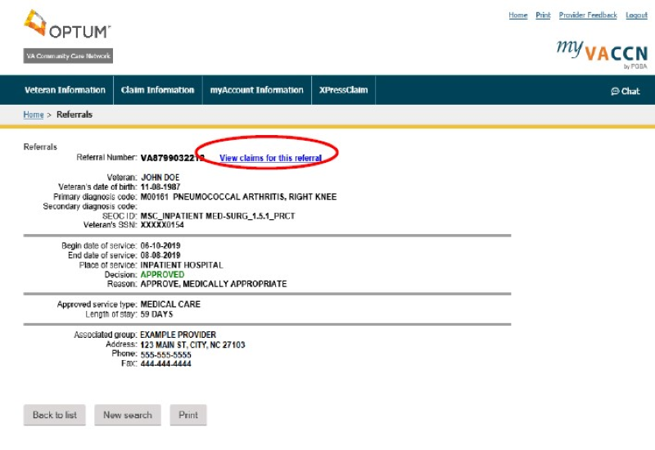
Notes:
This will show them the referral details.
The provider can see who the referral was approved for, what type of service, the length of time, etc.
If the providers desires to see claim information specific to this referral they can choose the “View Claims” hyperlink on the upper right

Slide 30
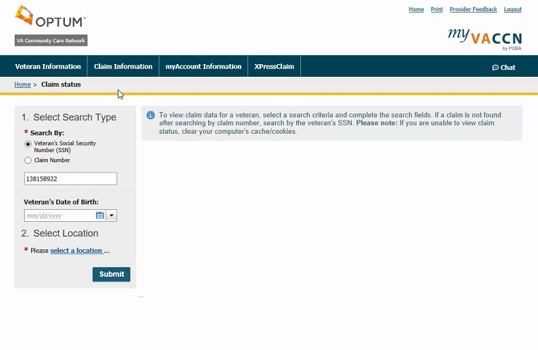
Users are responsible for ensuring they work from the latest approved version This document was last modified: 08/27/2019
Notes:
If the provider is not navigating to the claims section via hyperlink of the referral – this is what the general claim status screen looks like
To view claims for a Veteran, enter the Veteran’s SSN and date of birth (if known) or Claim Number and select the provider location.
Like LINK, the provider can only pull claims associated to their specific TIN/location.

Slide 31
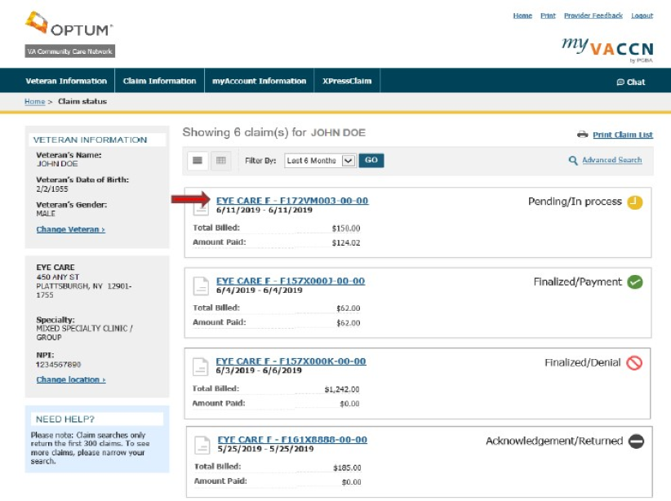
Users are responsible for ensuring they work from the latest approved version This document was last modified: 08/27/2019
37
Notes:
Once this information is submitted the results of the claims status search will appear.
At a quick glance the providers are able to see the total billed amount, the total amount paid, and the status of the claim
If the provider needs more details surrounding a particular claim they would select the hyperlink associated with the claim.

Slide 32
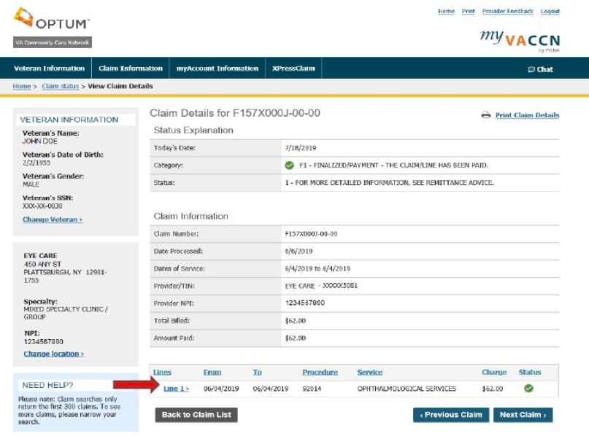
VA Community Care Network
38
Notes:
This shows what the provider will see when they choose that hyperlink.
They will be able to view line detail to include the procedure codes and payment for each
This information can also be printed.
Notice that at the top of this screen there is the “chat” feature. Providers can start an online chat with a claims representative directly from this page as well as the previous screens.

Slide 33
Thank you.
PCA-1-20-00539-OPTUM-PRES-03062020
Notes:
Thank you for learning more about the Department of Veterans Affairs (VA) Community Care Network.

