Slide 1



Provider Education
Martin’s Point Health Care
Copyright 2018, Martin’s Point Health Care, Inc. These materials may not be reproduced or distributed without the prior written permission of Martin’s Point.

Slide 2

Overview
Introduction
Overview of Martin’s Point Health Care
  Who We Are
  What We Do
Martin’s Point Health Plans
  US Family Health Plan
  Generations Advantage
Provider Online Tools & Resources
Onboarding & Additional Education
How to Contact Us

Slide 3


Who We Are
NMD
Headquartered
in Portland, Maine
Not-for-profit
Physician-led
Certified Great Place to Work® since 2016

Slide 4
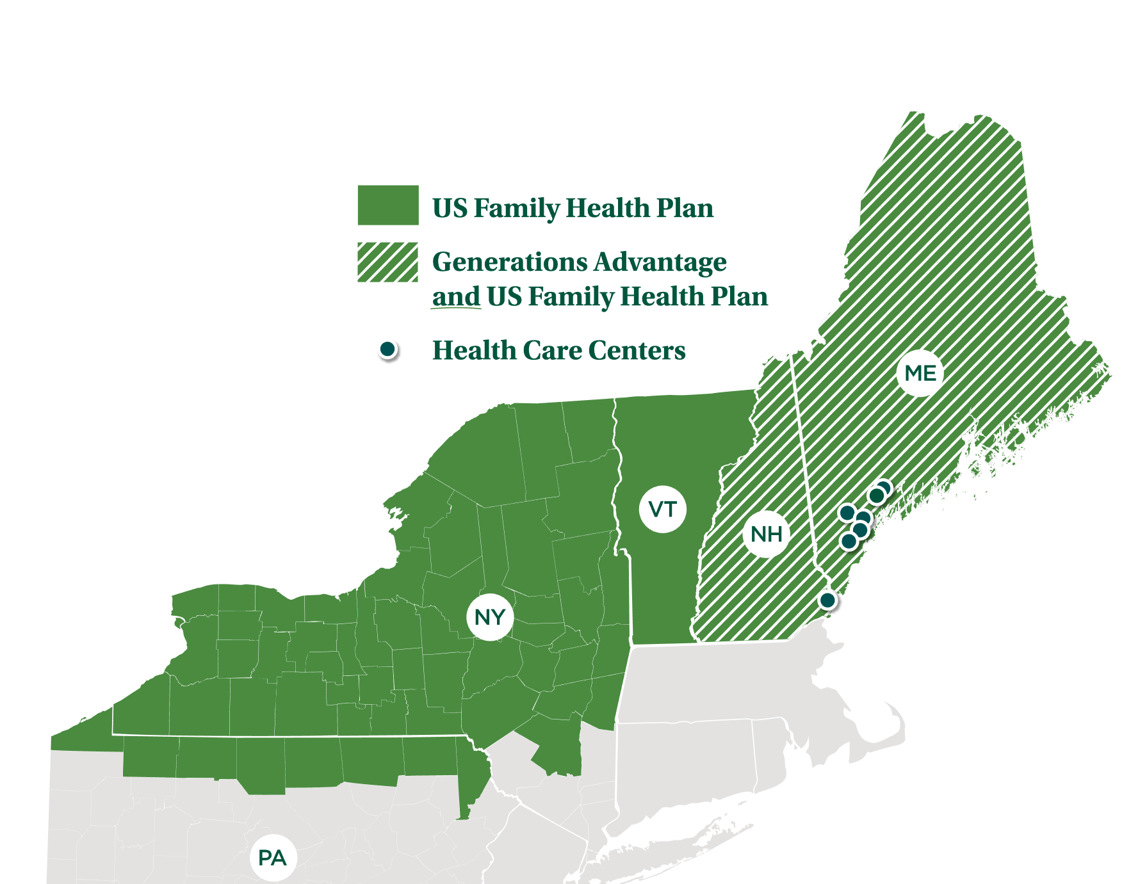


What We Do

Slide 5
Our Health Plans

Slide 6
Our Health Plans
We offer two federally administered health plans:
Martin’s Point US Family Health Plan
Our TRICARE Prime® plan covers over 46,500 active-duty and retired military family members in Maine, New Hampshire, Vermont, upstate New York, and northern Pennsylvania.
Martin’s Point Generations Advantage
Our Medicare Advantage plans cover seniors in Maine and New Hampshire.
These are Maine’s most popular Medicare Advantage plans with over 55,000 current members.
Quality Ratings
Both of our health plans are among the highest rated in the country for quality and customer service.

Slide 7
US Family Health Plan: Details & Benefits
Active-duty family members
Complete medical, hospital, and prescription drug coverage.
Low or no copayments in-network.
Low prescription drug copays.
Out-of-network flexibility for certain services with
Point of Service (POS) benefit.
Retirees, survivors,
and family members
The US Family Health Plan goes beyond traditional TRICARE® Prime benefits to offer excellent customer service and value-added benefits, including discounts on:
Eyewear
Hearing aids
Fitness memberships
More

Slide 8
Generations Advantage: Details & Benefits
Medicare Advantage plan types
  HMO-POS, HMO, RPPO, LPPO, and HMO SNP
  Market locations: Maine and New Hampshire
All Martin’s Point Generations Advantage plans go beyond traditional Medicare to include value added benefits including:
$0 in-network preventive screenings/care
No medical/hospital deductibles
$0 annual in-network physical exam and wellness visit
Annual out-of-pocket maximum
Worldwide urgent & emergency care
Hearing aids and batteries
Over-the-counter items
Wellness Wallet reimbursements

Slide 9
Generations Advantage: Going Beyond Medicare in 2021
All Plans
MSB Out of Country Policy
MSB Hearing Aids Policy
MSB Fall Prevention Policy - Clinically Nuanced
MSB Outpatient Behavioral Health Policy- Clinically Nuanced
MSB Dietary Support Program - Clinically Nuanced
MSB Acupuncture and Massage Policy - Clinically Nuanced
MSB Bathroom Safety Policy- Clinically Nuanced
MSB Eyewear Wellness Wallet Policy- All Plan Except Alliance
Alliance Plan
MSB Health Education Policy
MSB Meals Policy
MSB Personal Emergency Response System Policy
MSB Counseling Services Policy
MSB Eyewear Policy
MSB Fall Prevention Policy
MSB Chiropractic Services Policy
MSB Routine Chiropractor Policy
MSB Smoking Cessation Policy
MSB Bathroom Safety Policy

Slide 10
Provider Online Tools & Resources
NMD

Slide 11
TruCare ProAuth Electronic Authorization Tool
Benefits for providers:
  Reduces need to request additional information
  Real-time authorization submission, status tracking, and auto-authorization responses
  One-and-done authorization submissions
Features of ProAuth:
  Pre-screen
    Advanced capabilities for immediate response on the following:
      Participant eligibility
      Authorization required
      Duplicate authorization alert
  Interactive guidance
    Required information is identified for provider
    Authorizations can be auto-approved
  Authorization-specific structured notes and attachments
    Attach appropriate notes and attachments

Slide 12
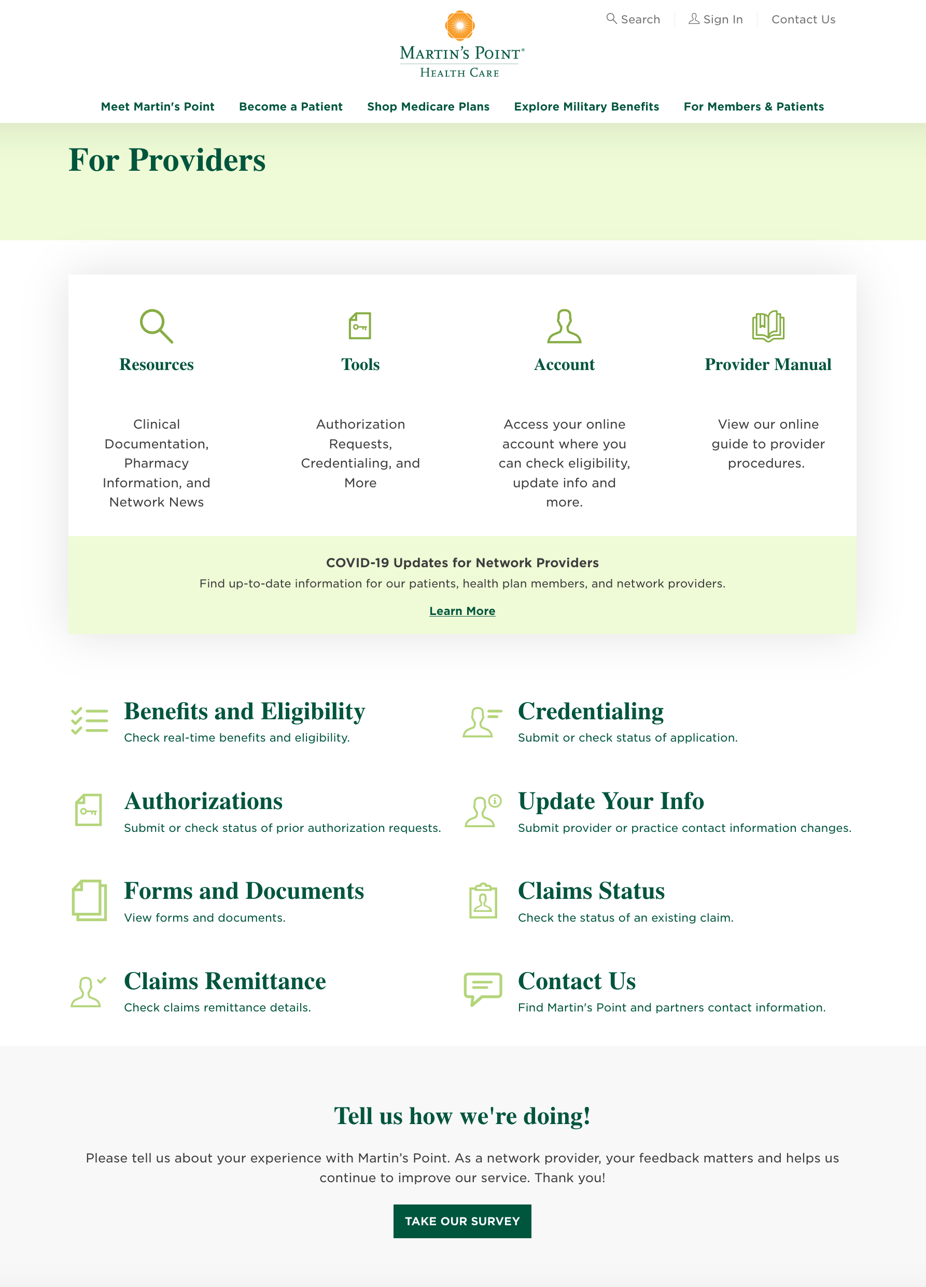
Online Tools & Resources
MartinsPoint.org/For-Providers
On our website you can:
View our provider manual
Get clinical documentation resources
Get pharmacy information
Submit/check status of prior authorizations
Submit/check status of credentialling applications
Check claims status and details
Check real-time benefits and eligibility
Change your provider/practice contact information
Login to our Provider Portal

Slide 13
Provider Portal Functions
Eligibility tool and how to search
Member management tool and how to search
Claims tool and how to search
Remittance advice tool and how to search
Authorization status tool and how to search
Martin’s Point contact information

Slide 14
Onboarding,
Additional Education & Contacting Us

Slide 15
Onboarding & Additional Education
  Participating providers are given initial onboarding and ongoing education to support delivery of high-quality care to Martin’s Point members.
  We’ve created an extensive training for our participating providers that we can deliver in a variety of ways:
    Email
    Conference call
    Zoom or Skype
    Webinars
    Seminars
    In-person visit (coming soon)
  Additional education and training modules are available on our website
    https://martinspoint.org/for-providers
  Our Provider Manual includes a guide to provider procedures

Slide 16
Contact Us
Provider Relations: Education, Contracts
  Phone: 1-800-348-9804
  Fax: 207-828-7870
  Email: Network.Management@MartinsPoint.org
Comprehensive Visit Program
  Check status information, please send email to: CDI@martinspoint.org
  For general questions about the program, including a request for onsite education or Comprehensive Visit Form submission guideline clarification, send email to: Network.Management@MartinsPoint.org or call (207) 766-3185
Provider Inquiry Department: Eligibility, Benefits, Claims, General Information
  Phone: 1-888-732-7364
Health Management Department: Preauthorization, Discharge Planning, Medical-Necessity Reviews, Subacute, Home Care, Transplant Services
  Phone: 1-888-339-7982
  Fax: 207-828-7865
Provider Data Integrity: Provider Data Change Request
  Email: Providerchanges@MartinsPoint.org
We want to hear from you!
Please click the survey link to complete our provider survey. Thank you!
https://www.surveymonkey.com/r/TVQ7TLJ

